Slide 1
PDB-04-000 Online Resources for Seafarers
PARTNER.SHIP.REDEFINED.

Slide 2
ONLINE RESOURCES FOR SEAFARERS 4 PLATFORMS
Marlow Crew Portal
Marlow crewcompanion app
Marlow vessel portal
Seagull training admin platform (sta)
to access these platforms we will need your active personal email address. If necessary, please contact your local agent or crew manager to update your database file.

Slide 3
ONLINE RESOURCES FOR SEAFARERS CREW PORTAL. What’s inside?

Slide 4
ONLINE RESOURCES FOR SEAFARERS CREW PORTAL. HOW DO I ACCESS IT?
Marlow Crew Portal
Accessible via your web browser
First time users need to register for an account VIA THE LOGIN PAGE using your marlow id and date of birth. You will then receive an email via your private email account. This email will contain a link and a one time password (otp) Using this link and otp you will be able to create your own password. Next time you login you will use your marlow id and personal password
If you forget your password you can create a new one via the login page

Slide 5
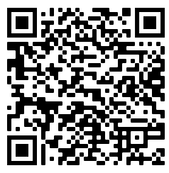
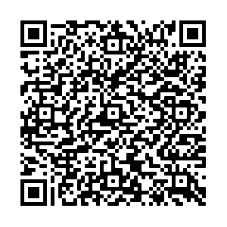
ONLINE RESOURCES FOR SEAFARERS CREW PORTAL. LINKS AND SUPPORT
Login page (click here or use the qr code)
Registration Guide (click here or use the qr code)
Email support: feedback.crewportal@marlowgroup.com Please always Include your marlow id in the email message

Slide 6
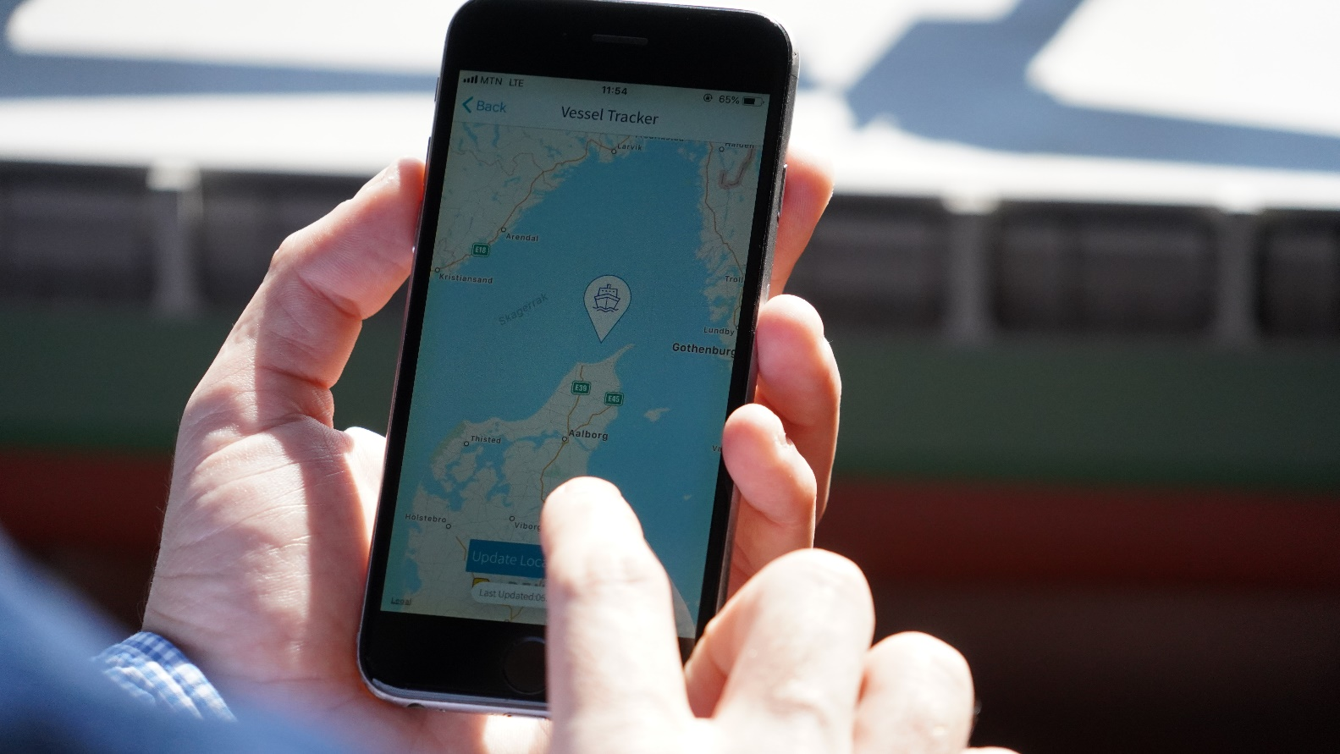
ONLINE RESOURCES FOR SEAFARERS CREWCOMPANION APP. What’s inside?
Assignment details (vessel details, employment offer etc)
Vessel tracker (present assignment)
Flights (present assignment)
Chat tool (mn seafarers within 30km)
Notifications (new assignment, flights, expiring docs etc)
Profile details
Documentation (travel docs, stcw licenses etc)
Salary records (present assignment)
Contact info (crew manager / port agent)
Sea service records
Working clothes allocation (present assignment)
News (press releases / newsletters)
Covid 19 guidelines
Crew portal (link)
MORE TO FEATURES TO FOLLOW....

Slide 7
ONLINE RESOURCES FOR SEAFARERS CREWCOMPANION APP. HOW DO I ACCESS IT?
Marlow crewcompanion app
Accessible via your smart phone (ios and android)
Ios version is downloaded via the crew portal
Android version is downloaded via the google play store
First time users need to register for an account VIA THE LOGIN PAGE using your marlow id and PRIVATE EMAIL ADDRESS. You will then receive an email via your private email account. This email will contain a one time password (otp) Using this otp you will be able to create your own PERSONAL password. Next time you login you will use your marlow id and personal password
If you forget your password you can create a new one via the login page

Slide 8
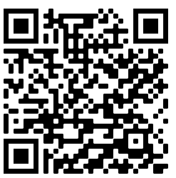
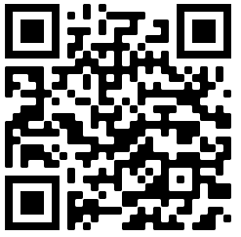
ONLINE RESOURCES FOR SEAFARERS APP. LINKS
IOS DOWNLOAD: via Crew Portal
Click here or use QR code
Web page: https://marlow-navigation.com/en/crewcompanion

Slide 9
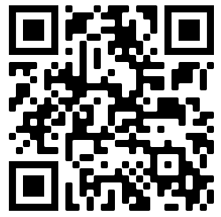
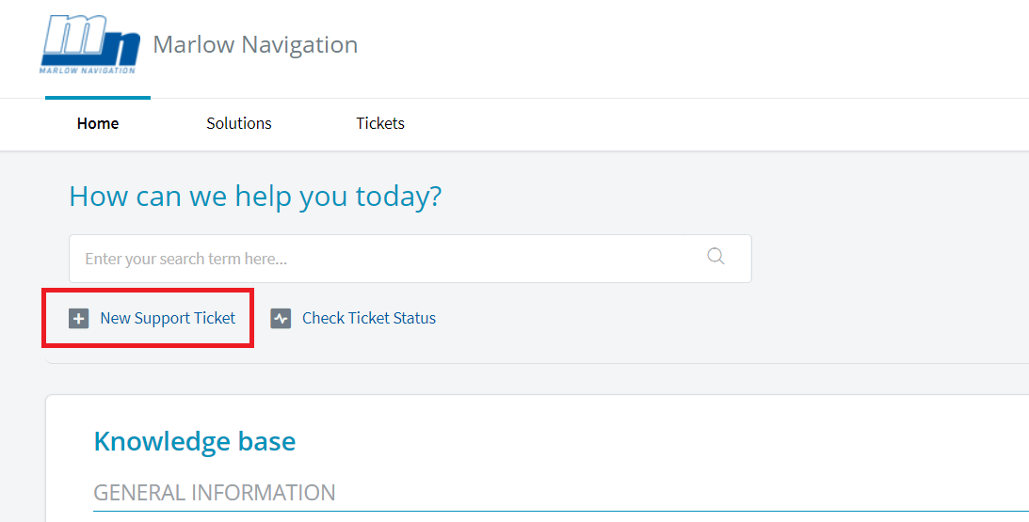
ONLINE RESOURCES FOR SEAFARERS APP. SUPPORT
DEDICATED support WEB PAGE: please visit the following web page and use the Knowledge Base to search for solutions:
https://crewcompanion.freshdesk.com/support/home
If none of the published articles on this page solve your issue / answer your question, then please submit a Support Ticket via the “New Support Ticket” option. When completing the form please always include your Marlow ID number in the ‘Subject’ field. Where applicable, please also upload a screen shot that illustrates your issue.
A support representative will be reviewing your request and will send you a personal response,(usually within 24 hours). You will also receive a link to the ticket in order to track the status or add comments.

Slide 10
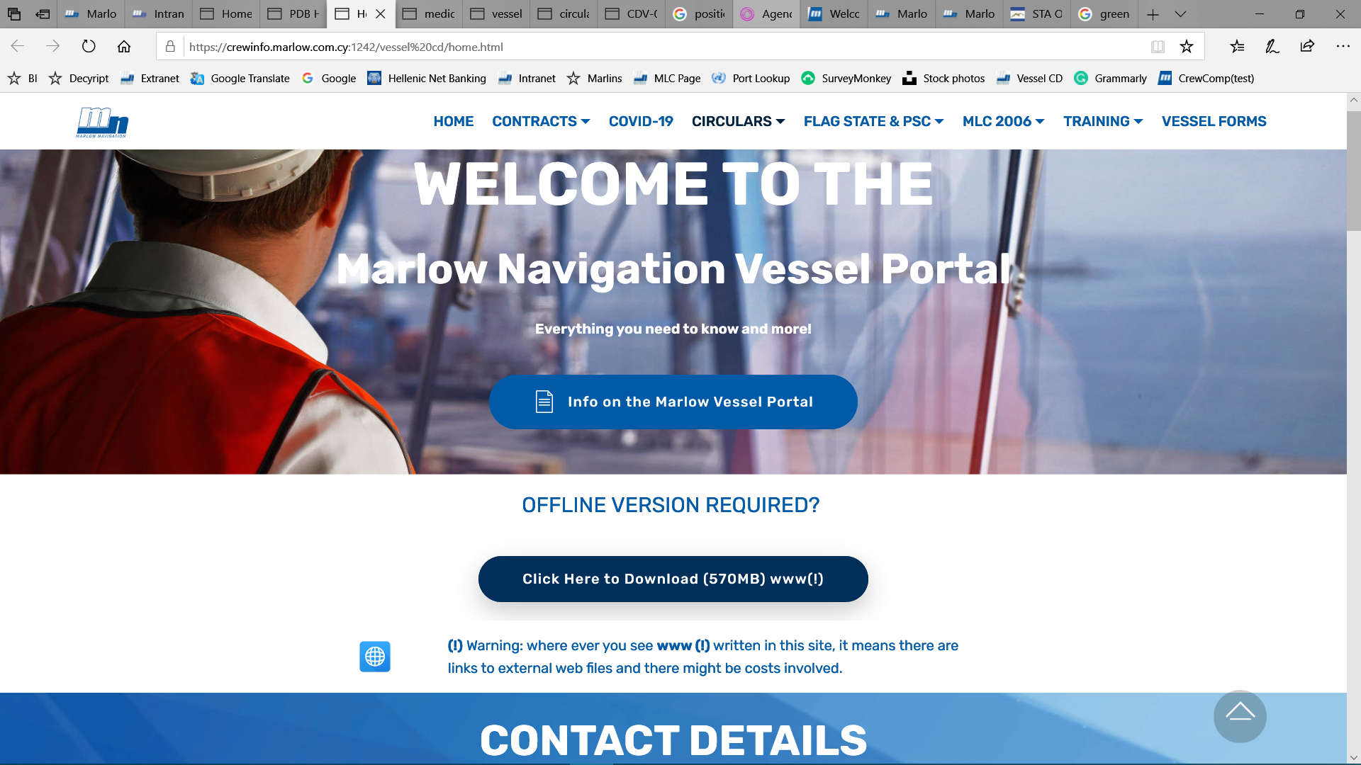
ONLINE RESOURCES FOR SEAFARERS VESSEL PORTAL. What’s inside?
MARLOW OFFICE / PORT AGENCY CONTACT DETAILS
TELEMEDICAL CONTACT INFO FOR MEDICAL EMERGENCIES
TRAINING MATERIALS (GUIDELINES, INDUCTION CHECKLISTS, DOCS FOR TRAINEES ETC)
HEALTH AND WELLBEING GUIDANCE
CONTRACT INFO (CBA’S, T&C, FLAG APPROVALS ETC)
VESSEL CIRCULARS
FLAG AND PORT STATE CONTROL INFO AND GUIDANCE
MLC 2006 INFO (APPROVED MEDICAL CLINICS, P+I ENTRY CERTS, MLC OFFICE CERTS, ONBOARD COMPLAINT CONTACT DETAILS ETC)
VESSEL FORMS (ACCOUNTING AND CREWING)

Slide 11
ONLINE RESOURCES FOR SEAFARERS VESSEL PORTAL. No CD’s as of Aug 2020
AS PER VESSEL CIRCULAR: CDV-00-074 (UPDATED 7TH AUG 2020)
WE WILL NO LONGER BE SENDING / MAILING CD’S TO ALL VESSEL
A LIVE VERSION IS AVAILABLE VIA THE CREW PORTAL
AN OFFLINE VERSION CAN ALSO BE DOWNLOADED VIA THE CREW PORTAL
IMPORTANT UPDATES WILL CONTINUE TO BE SENT ON BOARD VIA EMAIL
A FULL REVIEW AND UPDATE OF ALL CONTENT WILL BE PERFORMED ANNUALLY

Slide 12
ONLINE RESOURCES FOR SEAFARERS VESSEL PORTAL. HOW DO I ACCESS IT?
Marlow VESSEL Portal (EX VESSEL CD)
Accessible via THE CREW PORTAL
First time users need to register for an account VIA THE LOGIN PAGE using your marlow id and date of birth. You will then receive an email via your private email account. This email will contain a link and a one time password (otp) Using this link and otp you will be able to create your own password. Next time you login you will use your marlow id and personal password
If you forget your password you can create a new one via the login page

Slide 13
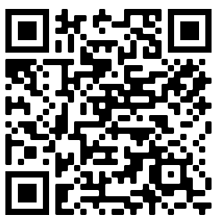
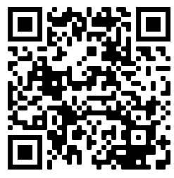
ONLINE RESOURCES FOR SEAFARERS VESSEL PORTAL. LINKS AND SUPPORT
Login page (click here or use the qr code)
Registration Guide (click here or use the qr code)
OFFLINE VERSION DOWNLOAD LINK:
https://mnmedia.marlow-navigation.com/VesselCD/VesselCD.zip
Email support: feedback.crewportal@marlowgroup.com

Slide 14
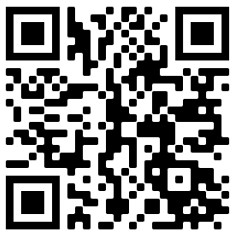
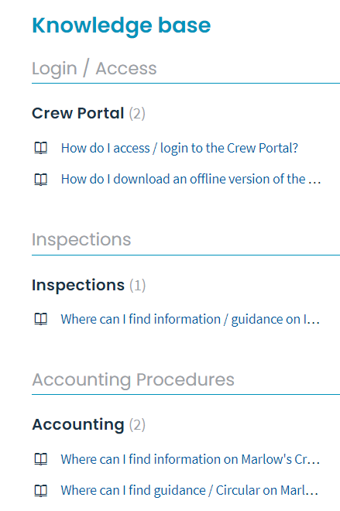
ONLINE RESOURCES FOR SEAFARERS VESSEL PORTAL. NEW FAQ Page
Have a question... Need help finding something?
Check the articles or search by entering a question or key word
https://vesselportal.freshdesk.com/support/home

Slide 15
ONLINE RESOURCES FOR SEAFARERS CONNECTING SUPPORT VIA EMAIL
PLEASE ALWAYS INCLUDE YOUR MARLOW ID AND FAMILY NAME
PLEASE MAKE SURE THAT YOU ARE SENDING YOUR MESSAGE TO THE CORRECT EMAIL ADDRESS: feedback.crewportal@marlowgroup.com feedback.app@marlowgroup.com
PLEASE INCLUDED SCREEN SHOTS WHERE APPLICABLE

Slide 16
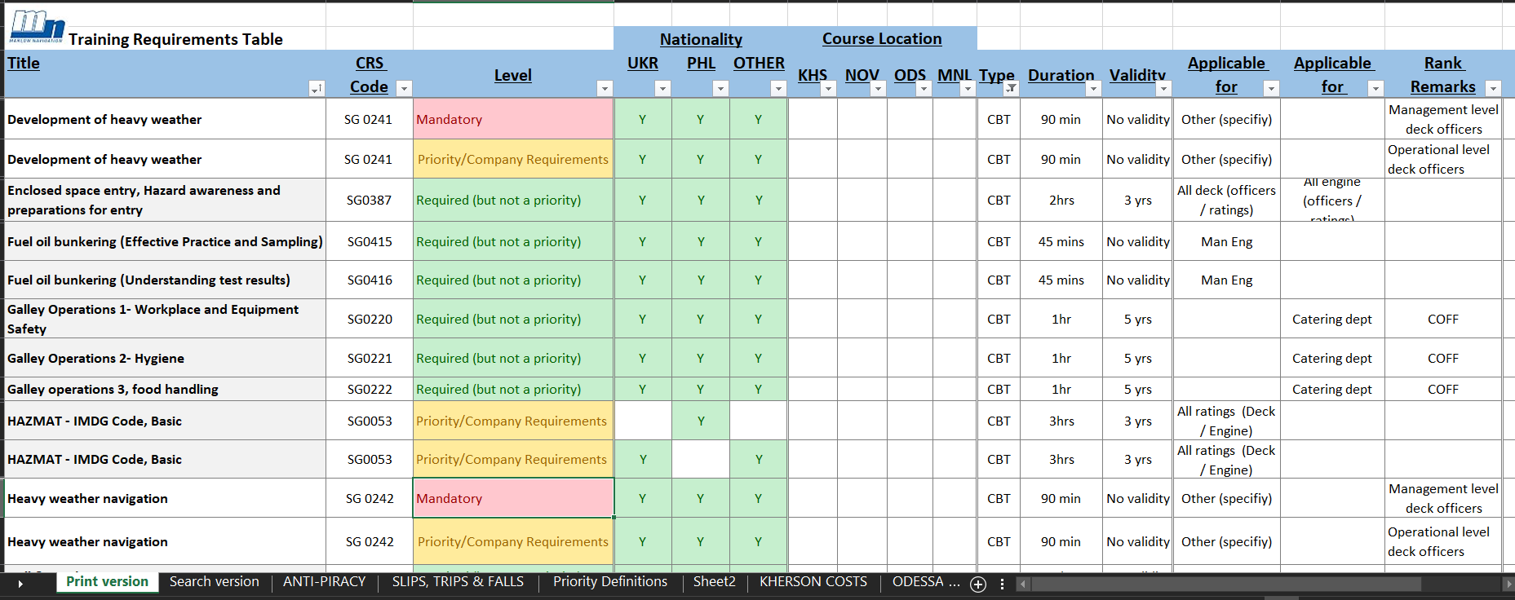
ONLINE RESOURCES FOR SEAFARERS SEAGULL STA. What’s inside?
NOW REBRANDED TO AS ‘OCEAN LEARNING PLATFORM’
ALL E-LEARNING MODULES (PREVIOUSLY KNOW AS CBT’S)

Slide 17
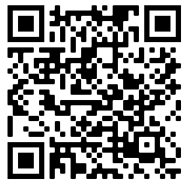
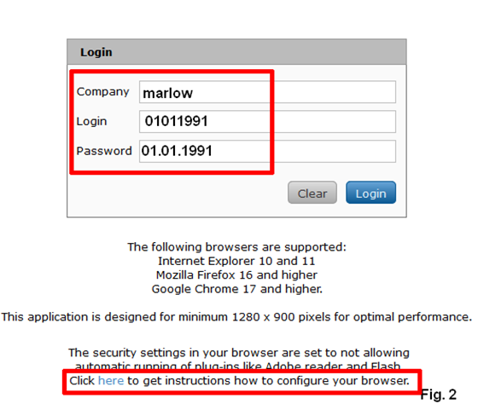
ONLINE RESOURCES FOR SEAFARERS SEAGULL STA. HOW DO I ACCESS IT?
SEAGULL STA
Accessible via your web browser

Slide 18
ONLINE RESOURCES FOR SEAFARERS SEAGULL STA. Passing Grades
Passing Score: 75% to 100%
Lessons completed: You must read all lessons and slides, and must reach a completion ratio of 95% to 100%.
Note: If you score below 75% or complete the lessons below 95%, the training shall be considered FAILED.
How to check if PASSED or FAILED:
Click Records tab
Click E-learning tab

Slide 19
ONLINE RESOURCES FOR SEAFARERS SEAGULL STA. LINKS AND SUPPORT
Login page: https://sta.seagull.no/GCCProxy/views/customerloginscreenview.aspx
Registration Guide: ASK YOUR AGENT FOR A COPY OF AGENCY CIRCULAR CDA-00-063
Email support: ct@marlowGROUP.com / support@sgull.com

Slide 20
THANK YOU!

